Slide 1
Psychology
Faculty

Slide 2
Psychology of
Health and Safety
The Master’s programme Psychology of Health and Safety of the Faculty of Psychology has received a certificate of international accreditation from FIBAA (Foundation for International Business Administration Accreditation). The programme matches quality requirements and demonstrates a level of excellence according to many criteria. FIBAA accredited Tomsk State University for the maximum period, up to 2021

Slide 3
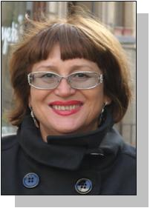
Psychology of Health and Safety
Programme objectives:
a high level of knowledge and practical skills in health and safety psychology
preparation for further academic research
career development as health and safety practitioners
Programme director:
Natalia V. Kozlova, Dr. of Sci., Professor
Head of Health Psychology Laboratory
Head of Genetic and Clinical Psychology Department

Slide 4
Psychology of Health and Safety
Career prospects:
psychological support for people experienced crisis and traumatic events
psychological support for people involved in dangerous occupations
psychological rehabilitation in post traumatic stress disorder
clinical psychological support of children’s development
socio-cognitive rehabilitation technologies of health recovery
health as a value: a healthy way of living

Slide 5
Psychology of Health and Safety
Job opportunities:
Health care institutions
Educational institutions
Research-oriented universities
Organizations under the Defence Ministry, Emergency Situations Ministry, Internal Affairs Ministry
Non-commercial charity organizations
Centers of psychological help and counseling

Slide 6
Psychology of Health and Safety
Programme outcomes:
Start: 2011
Number of graduates: 24
Employment of graduates: 100%

Slide 7
Psychology of Health and Safety
Programme facts:
Qualification | Master’s degree
Qualification name | Psychology of Health and Safety
Duration | 2 years full-time, 2.5 years part-time
Entry requirements | Bachelor’s degree, Specialist Diploma
Start date | September 1
Location | Faculty of Psychology

Slide 8
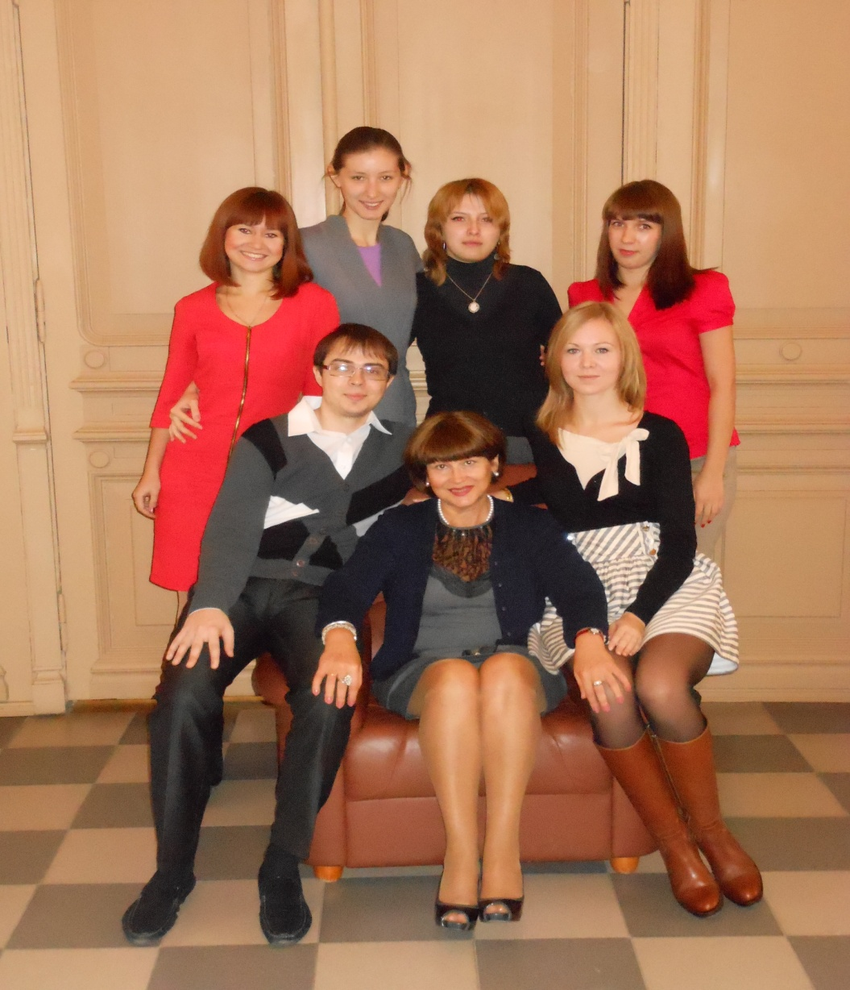
Psychology of Health and Safety
Enrollment to the Programme
Geography:
Russia:
Tomsk
Novosibirsk
Kemerovo
Altaysky kray
Khanty–Mansi AO
Buryatia
Kazakhstan
Uzbekistan

Slide 9
Psychology of Health and Safety
Programme foci:
a variety of topics concerned with health and safety psychology
experienced and highly qualified teaching staff
internal and external collaboration:
departments
laboratories
universities
employers
problem-based learning
orientation to research and practice
ESP competence development
involvement in granted research projects

Slide 10
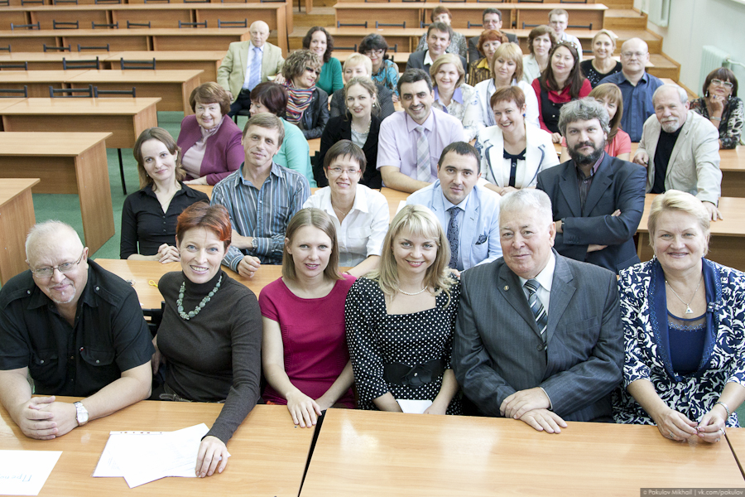
Psychology of Health and Safety
Experienced and highly qualified teaching staff:

Slide 11
Psychology of Health and Safety
Experienced and highly qualified teaching staff:
doctoral degrees (Dr. of Sci., Cand. of Sci., PhD) – 100%
publications – RISC, Web of Science, Scopus
international conferences:
2015: Russia, Norway, Japan, Italy, Spain, Great Britain
international short-time internships:
2011 – La Sapienza, Rome, Italy
2012 – Université de Libre, Brussels, Belgium
2013 – La Sapienza, Rome, Italy

Slide 12
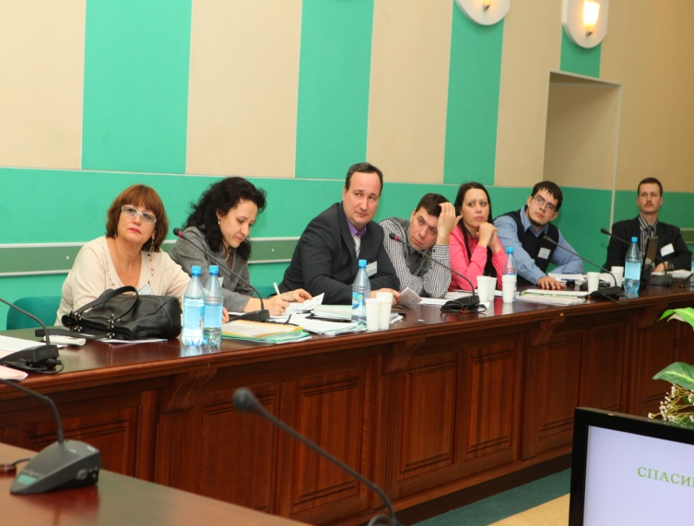
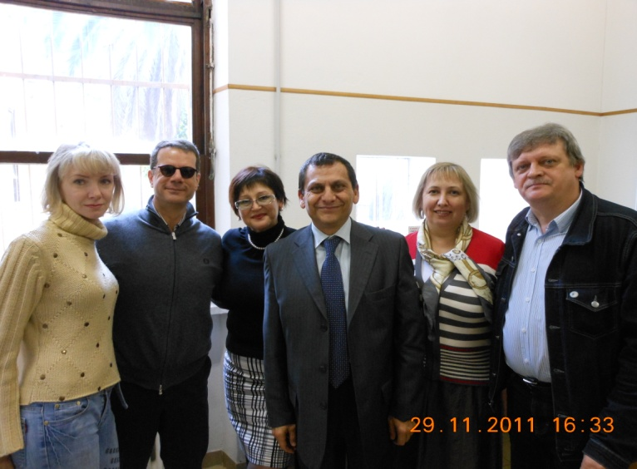
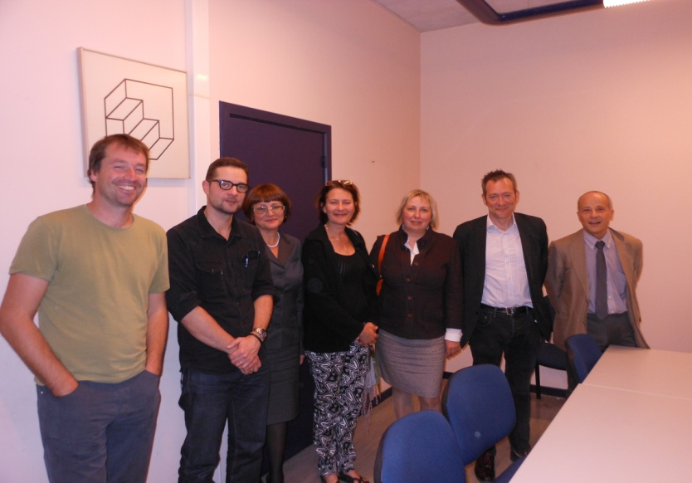
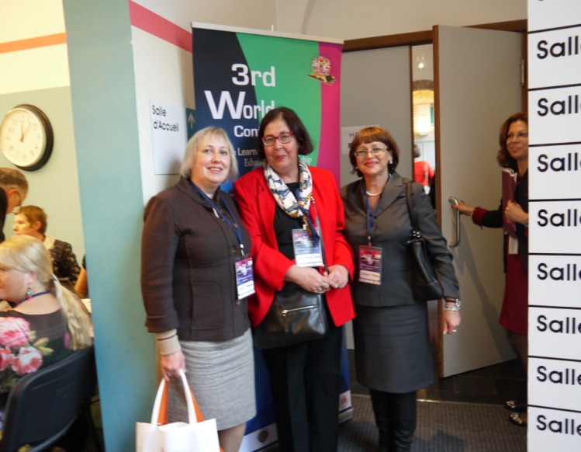
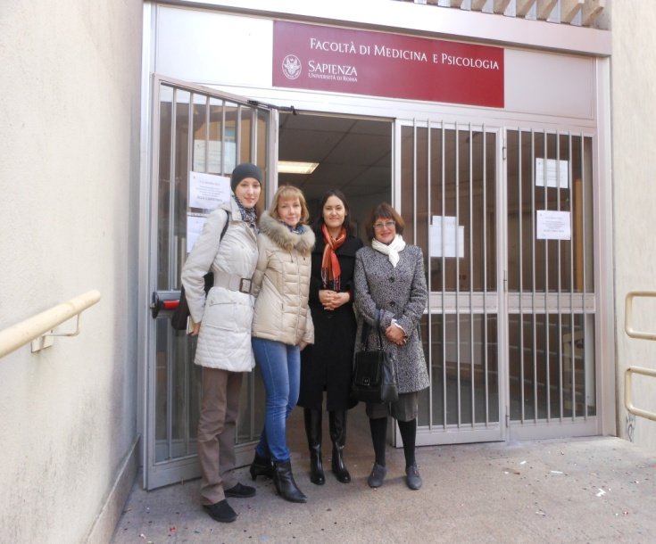
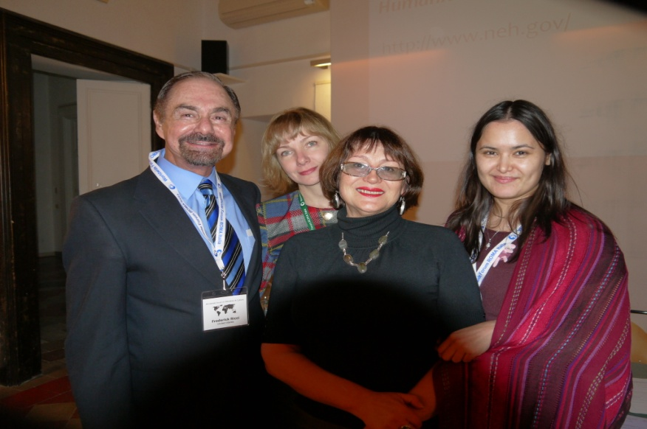
Psychology of Health and Safety
International conferences and short-time internships
Teaching staff and master’s students:

Slide 13
Psychology of Health and Safety
Internal collaboration
Departments:
Genetic and Clinical Psychology
Psychotherapy and Psychological Counseling
General and Pedagogical Psychology
Personality Psychology
Organizational Psychology
Management in Education
Master's programme

Slide 14
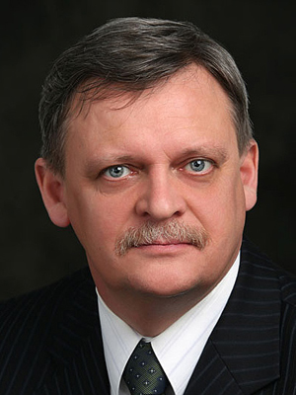
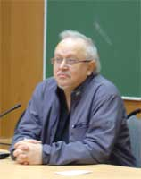
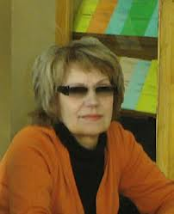
Psychology of Health and Safety
Internal collaboration:
Health Psychology
Laboratory
(Prof. Natalia Kozlova)
Psychophysiology
Laboratory
(Prof. Sergey Bogomaz)
Master's programme
Psychological Practice
Laboratory
(Prof. Valeriy Kabrin)
Laboratory for Cognitive Studies and Psychogenetics
Early Development Laboratory
(Prof. Yulia Kovas)
Psychological Expertise
Laboratory
(Prof. Emma Meshcheryakova)

Slide 15
Psychology of Health and Safety
Professional community:
Master's programme

Slide 16
Psychology of Health and Safety
Collaboration with employers:
Master's programme

Slide 17
Thank you!
National Research
Tomsk State University
36, Lenina Avenue, Tomsk, 634050, Russia
+7 (3822) 52-98-52, +7 (3822) 52-95-85 (fax)
rector@tsu.ru
www.tsu.ru

